Slide 1







Technology Trends Findings Report
Agata Rozpendowska
May 2024

Slide 2



OUTLINE
Executive Summary
Introduction
Methodology
Results
Visualization – Charts
Dashboard
Discussion
Findings & Implications
Conclusion
Appendix

Slide 3

EXECUTIVE SUMMARY
Current Technology Usage Trend
Programming Language
Database
Platform
Web frame
Future Technology Trend
Programming Language
Database
Platform
Web frame
Demographic Survey
Country & Gender Difference

Slide 4

INTRODUCTION
Purpose: Analysis of trends in software development
Research questions:
What are the programming languages and databases demanded in the present?
What are the programming languages and databases trends for the future?
Characteristics of a software developer

Slide 5

METHODOLOGY
Collecting data from the following sources:
Stack overflow developer 2019 survey
GitHub job postings
Programming languages annual salary
Data Wrangling
Data Exploration
Data Visualization
using IBM Cognos Analytics

Slide 6
RESULTS

Slide 7
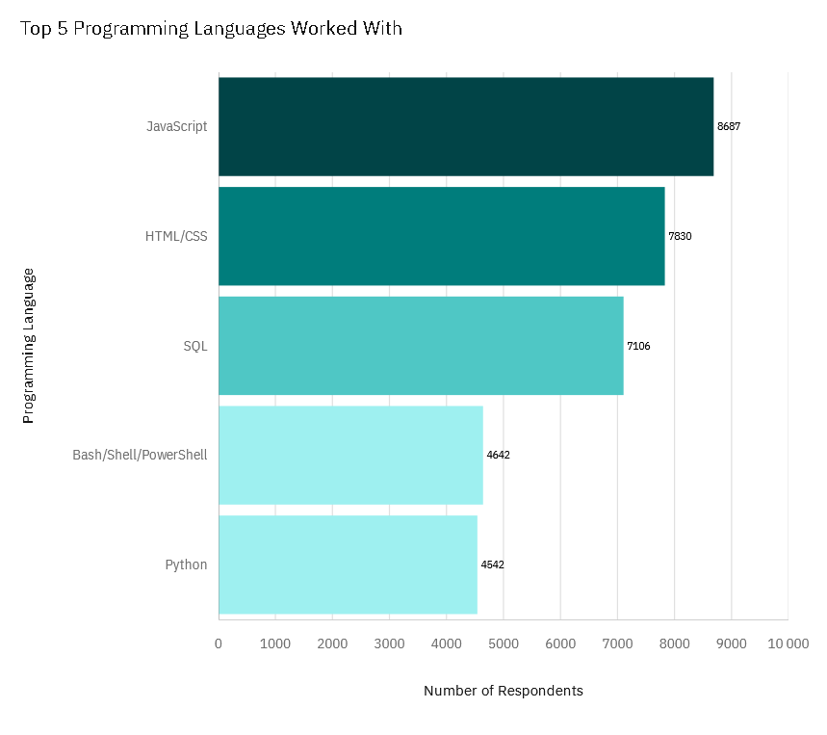
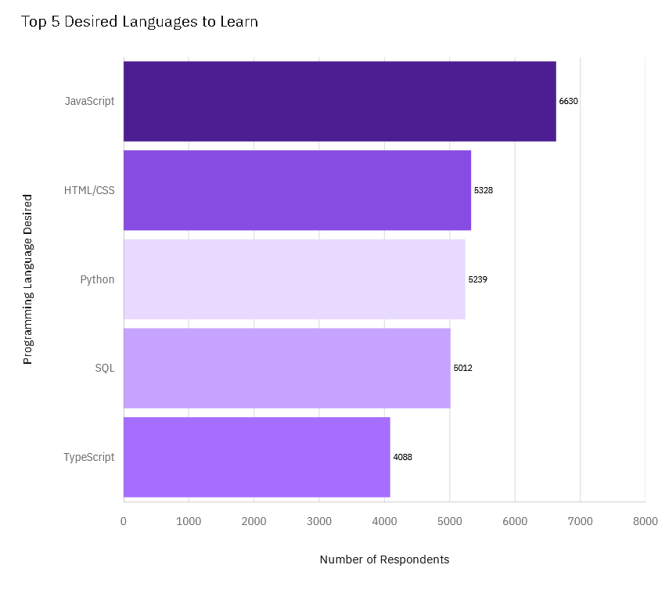
PROGRAMMING LANGUAGE TRENDS
Current Year
Next Year

Slide 8
PROGRAMMING LANGUAGE TRENDS - FINDINGS & IMPLICATIONS
Findings
JavaScript and HTML/CSS were the preferred languages this year as well as in the upcoming year
Python becoming third desired langiage to learn
PowerShell is not in the top 5 languages in the upcoming year
Implications
Web development technologies are still in high demand
Increasing desire to learn Python reflects industry interest in growing field of data science and research
Scripting languages like Powershell are declining while general-purpose programming languages like Python are becoming more popular

Slide 9
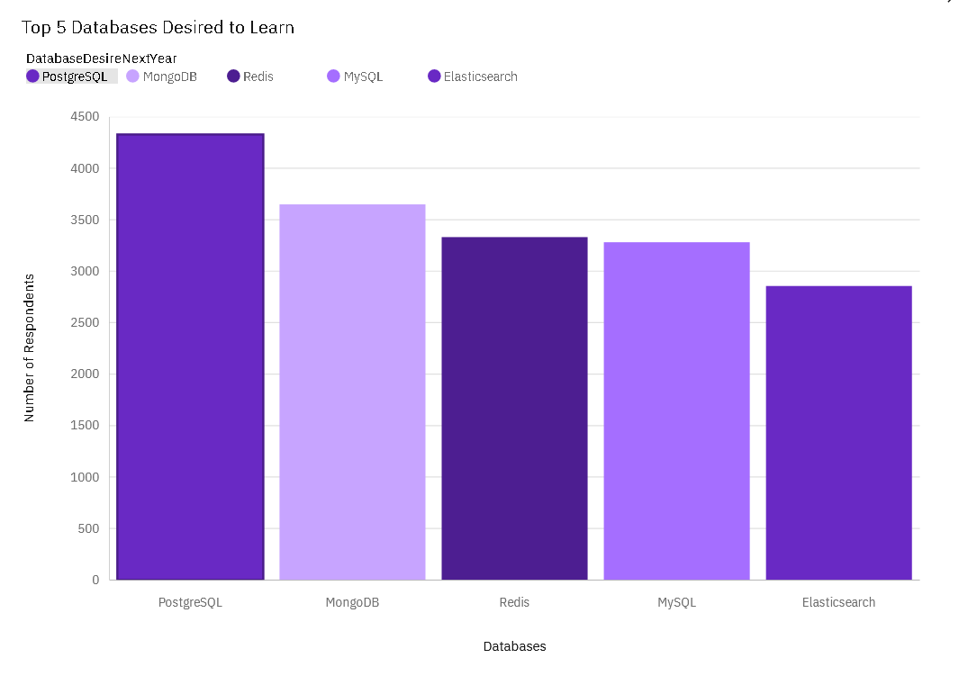
DATABASE TRENDS
Current Year
Next Year

Slide 10
DATABASE TRENDS - FINDINGS & IMPLICATIONS
Findings
Declining popularity of MySQL
Increasing interest in PostgreSQL and MongoDB
Oracle no longer in Top 10 databases
Elasticsearch to become the second most popular database used by developers
Implications
Open source databases will be preferred in the future (PostgreSQL, MongoDB, Redis)
Developers shifting from Oracle may be linked to factors such as high licensing costs, complexity, and the rise of more cost-effective and simpler alternatives
Elasticsearch efficiently store and search great volumes of data due to its search based on index rather then text. It can handle large volumes of data and high query loads. Its rising popularity may reflect industry’s demand for tools oriented for data science purposes

Slide 11


DASHBOARD
https://github.com/modjeskaa/IBM-Data-Analyst-Capstone-Project/blob/main/5%20Dashboard%20with%20IBM%20Cognos.pdf

Slide 12
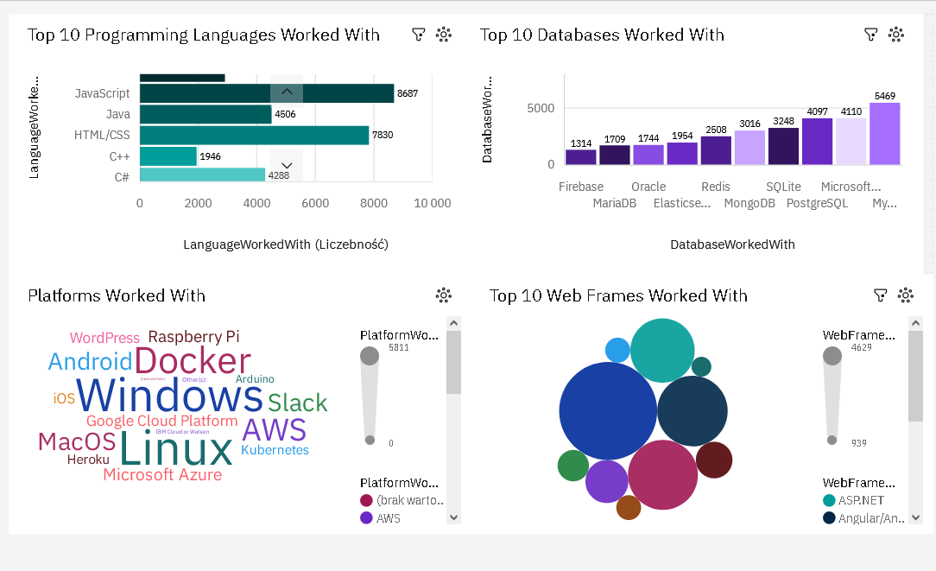
Current Technology Usage

Slide 13
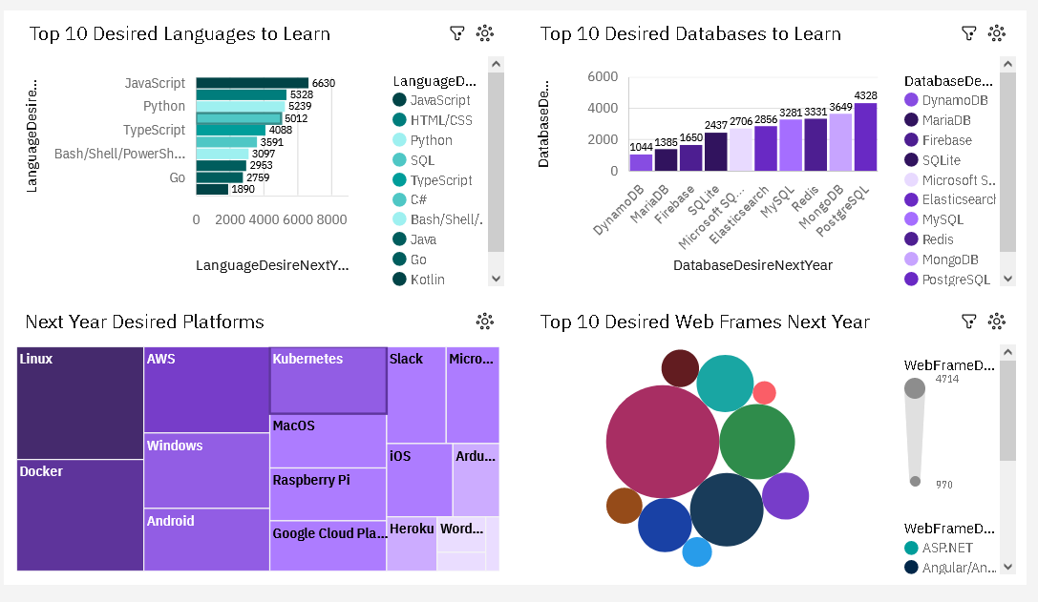
Future Technology Trend

Slide 14
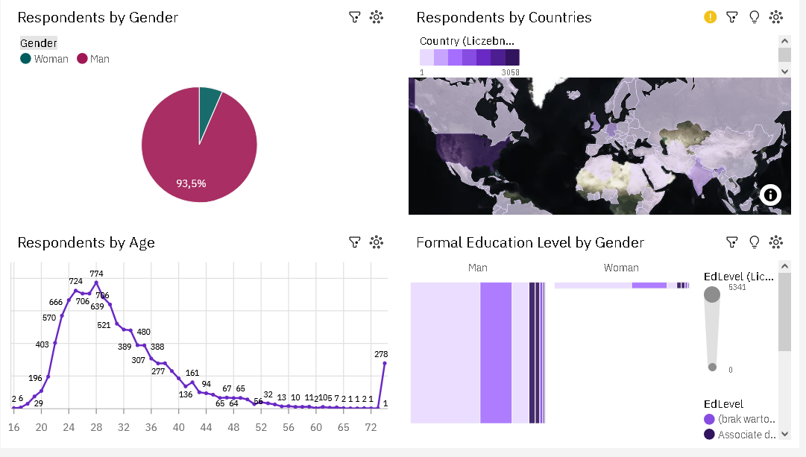
Demographics

Slide 15
DISCUSSION

Slide 16
OVERALL FINDINGS & IMPLICATIONS
Implications
Web Development Dominance
The high usage of JavaScript and HTML/CSS indicates a strong emphasis on web development. Continued interest in these languages suggests web development will remain a core focus area.
Growing Importance of Data Skills
Current SQL's high usage highlights the critical role of data management and manipulation in current applications. The desire to learn Python and SQL reflects an increasing need for data analysis and machine learning skills.
Shift in Database Preferences
Developers are moving towards open source databases, like PostgreSQL and MongoDB.
Oracle’s declining: The reduced interest in Oracle suggests companies are seeking more cost-effective and user-friendly alternatives.
Elasticsearch's Rise: The increasing popularity of Elasticsearch emphasizes the need for efficient search and analytics capabilities.
Demographics
Gender gap will affect job hiring
Products and services developed by a predominantly young male demographic may not fully address the needs and preferences of a diverse user base.
Findings
Programming Language Trends
Current Year: JavaScript, HTML/CSS, SQL, Bash/Shell/PowerShell, Python are the most worked with programming languages
Next Year: JavaScript, HTML/CSS, Python, SQL, TypeScript are the most desired programming languages to learn
Database Trends
Declining Popularity: MySQL is experiencing a decline in popularity
Increasing Interest: PostgreSQL and MongoDB are seeing growing interest
Oracle's Decline: Oracle is no longer in the top 10 databases
Rise of Elasticsearch: Elasticsearch is becoming the second most popular database among developers
Demographics
Over 90% of developers are young males
Developers mostly located in developed countries

Slide 17

CONCLUSION
JavaScript and HTML/CSS continue to be essential for web development, reflecting the ongoing importance of building and maintaining web applications. The interest in TypeScript suggests a trend towards creating more scalable and maintainable JavaScript codebases
Growing Demand for Data Skills: SQL remains critical for data management, while the increasing popularity of Python indicates a strong interest in data analysis, machine learning, and automation
Shifts in Database Preferences: The declining use of MySQL and Oracle points to a transition towards more modern, flexible, and cost-effective solutions like PostgreSQL and MongoDB. The rise of Elasticsearch underscores the need for powerful search and analytics capabilities in applications

Slide 18
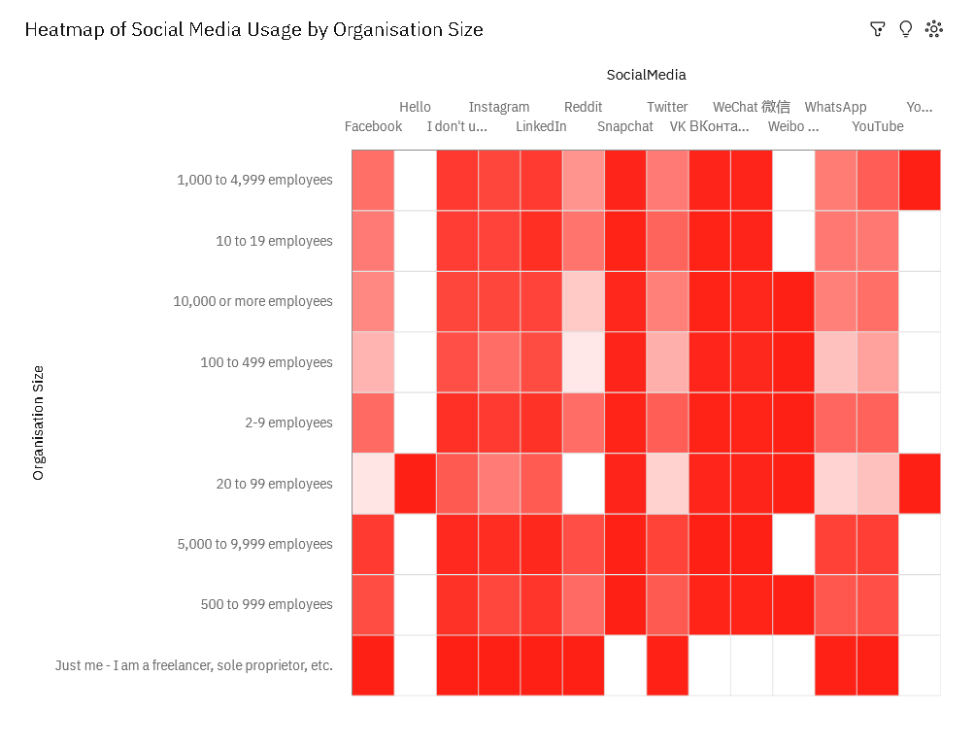

APPENDIX

Slide 19
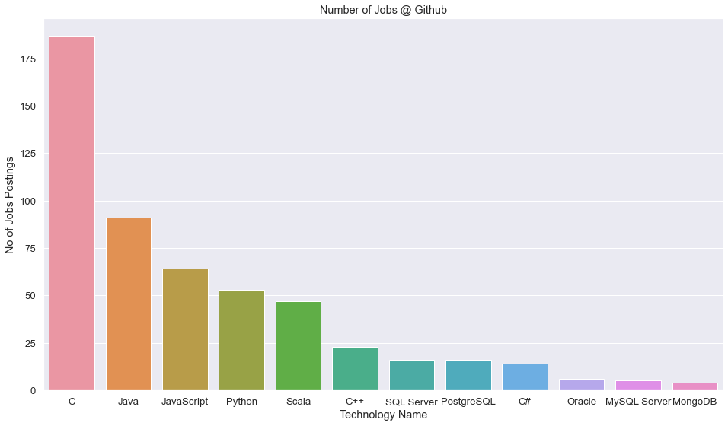
JOB POSTINGS

Slide 20
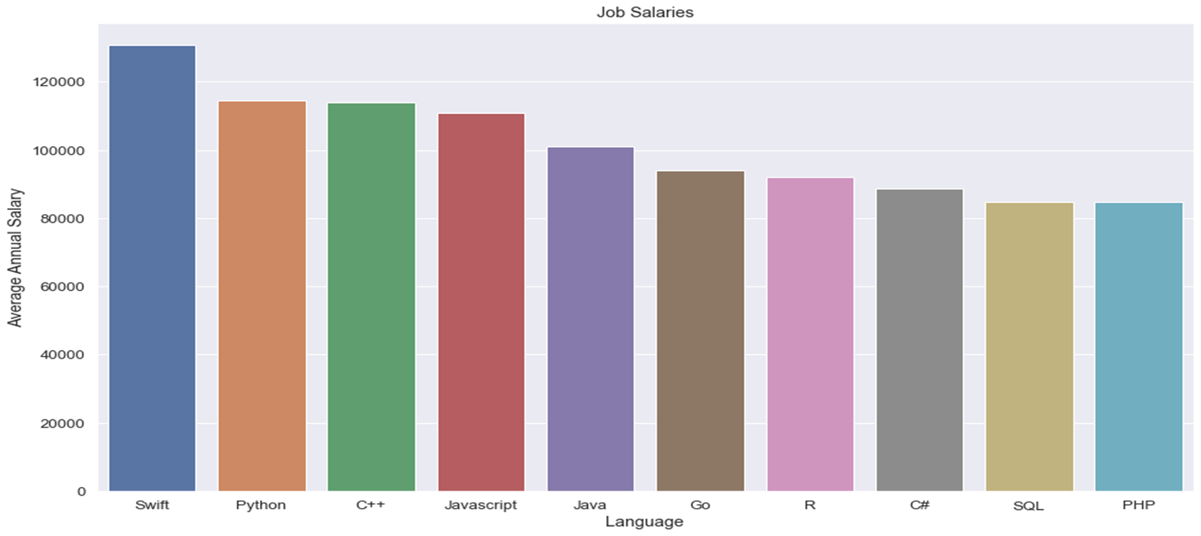
POPULAR LANGUAGES

